Slide 1
Tinkering Boot Camp
Week 4 Session 1
By Tinkerers’ Laboratory

Slide 2
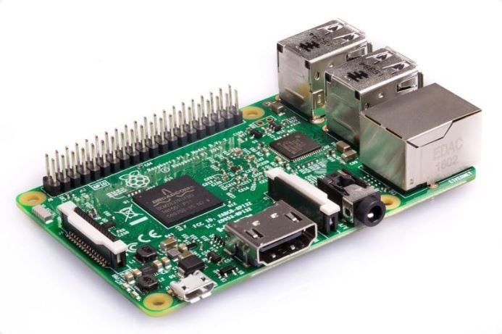
Raspberry Pi
The Raspberry Pi is a low cost, credit-card sized computer that plugs into a computer monitor or TV, and uses a standard keyboard and mouse.
It’s capable of doing everything you’d expect a desktop computer to do.
Later it came in hands of hobbyists and entered world of robotics and projects.

Slide 3
Specefications
Broadcom BCM2837B0, Cortex-A53 (ARMv8) 64-bit SoC @ 1.4GHz
1GB LPDDR2 SDRAM
2.4GHz and 5GHz IEEE 802.11.b/g/n/ac wireless LAN, Bluetooth 4.2, BLE
Extended 40-pin GPIO header
Full-size HDMI
4 USB 2.0 ports
CSI camera port for connecting a Raspberry Pi camera
DSI display port for connecting a Raspberry Pi touchscreen display
4-pole stereo output and composite video port
Micro SD port for loading your operating system and storing data
5V/2.5A DC power input
Power-over-Ethernet (PoE) support (requires separate PoE HAT)

Slide 4
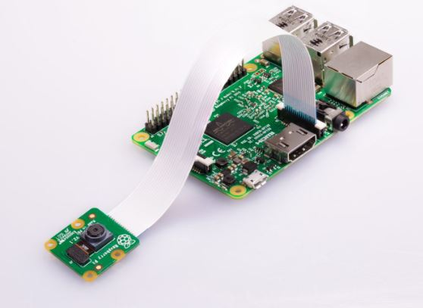
What can it do?
A General purpose Computer
Media Centre
Learn programming
Learn and make electronic projects
Take photos using camera module(in projects)
Use in Robotics
Network Storage
Weather Station
Retro Pi PlayStation
Anything you can think of!

Slide 5
What will you need to Start
Raspberry Pi
Keyboard and mouse
HDMI Cable
Power Cable
Display Screen(Monitor or TV)

Slide 6
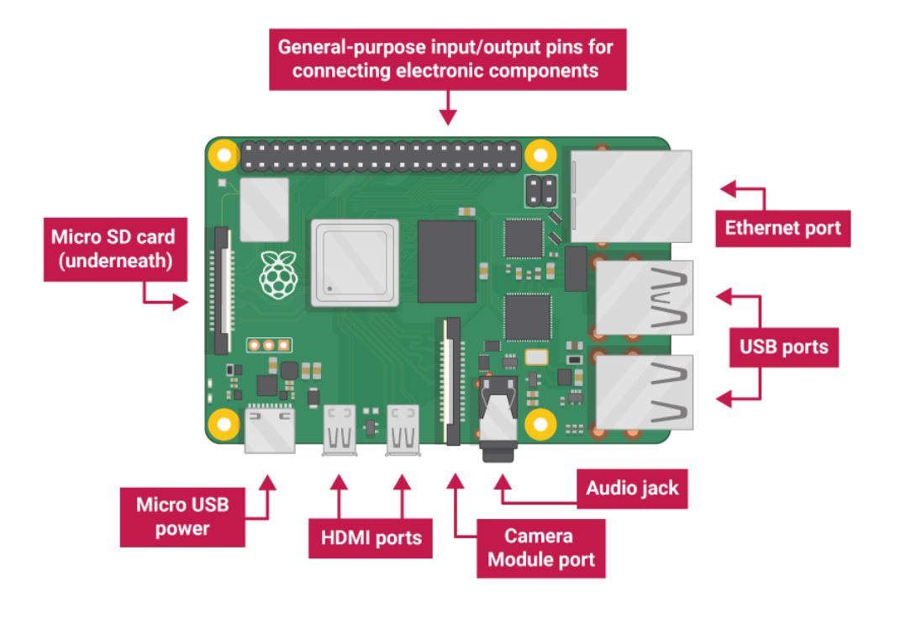

Slide 7
Tour of Raspbian
Jump to the Live Video
Text editor
Browsing Web
Games
Programming Languages
Add/Remove Software
Terminal

Slide 8
Linux Terminal Commands
https://www.raspberrypi.org/documentation/linux/usage/commands.md

Slide 9
SSH & VNC
Demo
Link to download VNC Viewer:
https://www.realvnc.com/en/connect/download/viewer/

Slide 10
Pyautogui
Pyautogui Functions used in the session:
click()
moveTo()
dragTo()
typewrite(“”)
typewrite([‘’])
press(‘’)
locateCenterOnScreen()
size()
https://pypi.org/project/PyAutoGUI/

